Slide 1

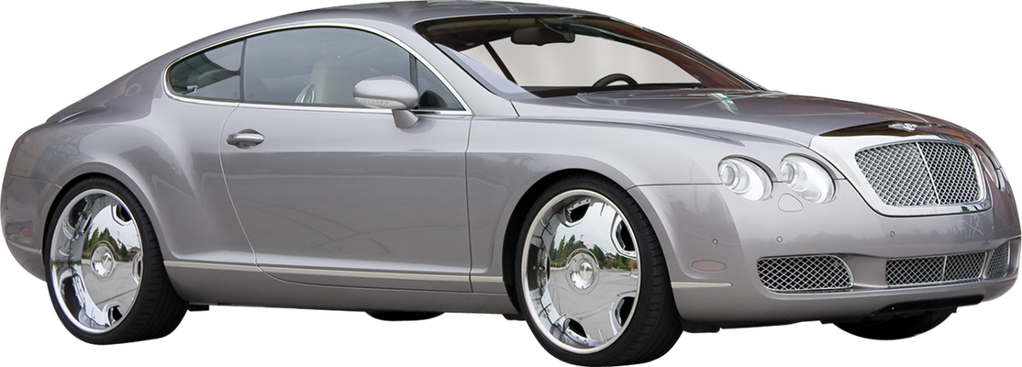

CAR PRICE PREDICTION
Using Exploratory Data Analysis (EDA) and Machine Learning (Random Forest)
Under the guidance of
Dr. Bhanu K.N.
SUBMITTED BY:
PRADEEP BURLI
24PG00078
Notes:
1

Slide 2

INTRODUCTION
Car price prediction helps estimate a fair market value for used vehicles.
Useful for buyers, sellers, and dealerships to make informed pricing decisions.
Involves analyzing key features like brand, year, mileage, and fuel type.
Uses Exploratory Data Analysis (EDA) and Machine Learning (Random Forest).
Goal: Build a reliable model to accurately predict car prices.

Slide 3

METHODOLOGY
Data Cleaning – Removed missing values, duplicates, and incorrect entries
Exploratory Analysis – Used visualizations to understand feature relationships
Feature Selection – Chose key predictors like brand, year, and mileage
Model Training – Applied Random Forest for accurate price prediction
Performance Evaluation – Achieved high R² score of 0.97

Slide 4

PROBLEM STATEMENTS
The goal is to predict the selling price of used cars based on various features such as brand, year, mileage, fuel type, and transmission.
This helps buyers and sellers make fair and informed pricing decisions in the used car market.

Slide 5

Exploratory Data Analysis (EDA)
Visualized feature distributions using histograms and boxplots
Analyzed correlations between variables using a heatmap
Identified important features like brand, year, fuel type, and transmission
Detected outliers and skewed data in mileage and price
Used bar plots and scatter plots to understand data trends

Slide 6

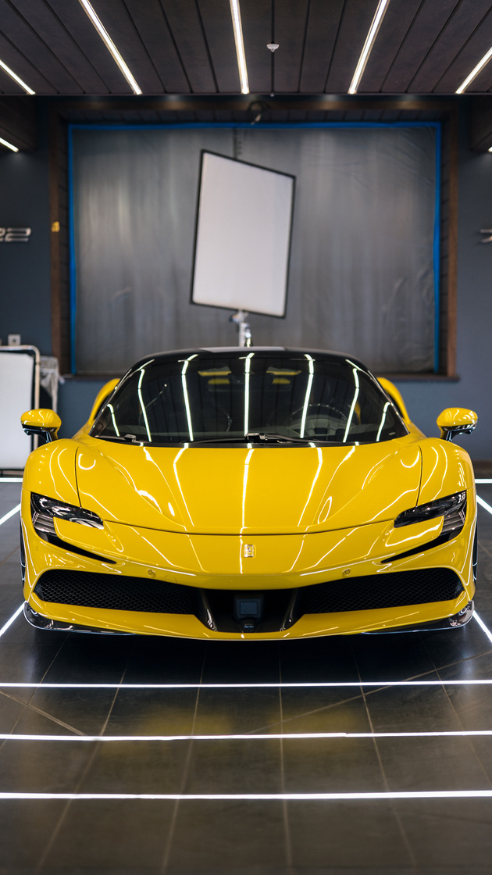

Model Evaluation
Evaluated model performance using the R² (coefficient of determination) score
Achieved a high R² score of 0.97, indicating excellent prediction accuracy
Compared predicted vs actual prices to assess model reliability
Used cross-validation to ensure the model generalizes well on unseen data
The model is stable, consistent, and suitable for real-world car price predictions

Slide 7
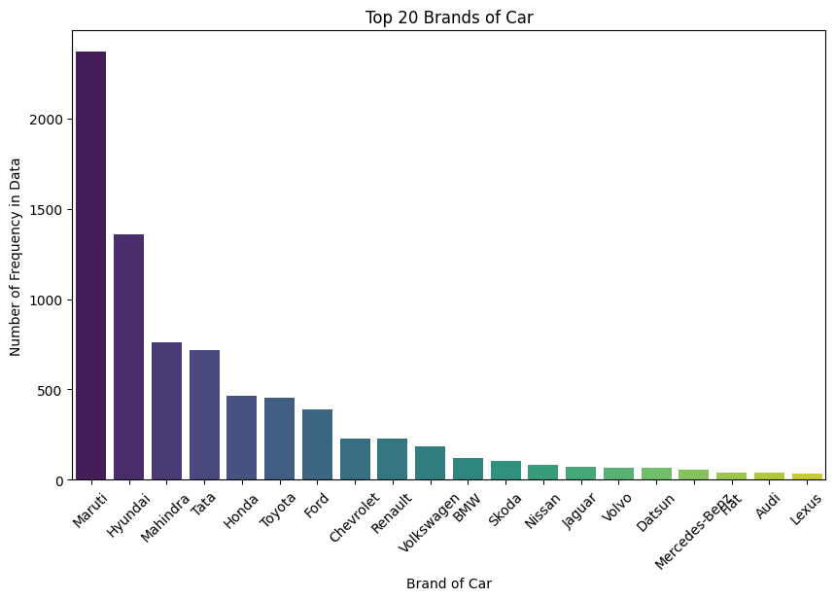
Results & Insights
Top 20 Car Brands
Maruti is the most frequently occurring brand, dominating the dataset
Followed by Hyundai, Mahindra, and Tata, indicating their popularity in the market
Premium brands like BMW, Mercedes-Benz, Audi, and Lexus appear less frequently, reflecting their niche status
The distribution suggests the dataset is skewed towards budget and mid-range cars
This trend can influence model predictions due to data imbalance among brands

Slide 8

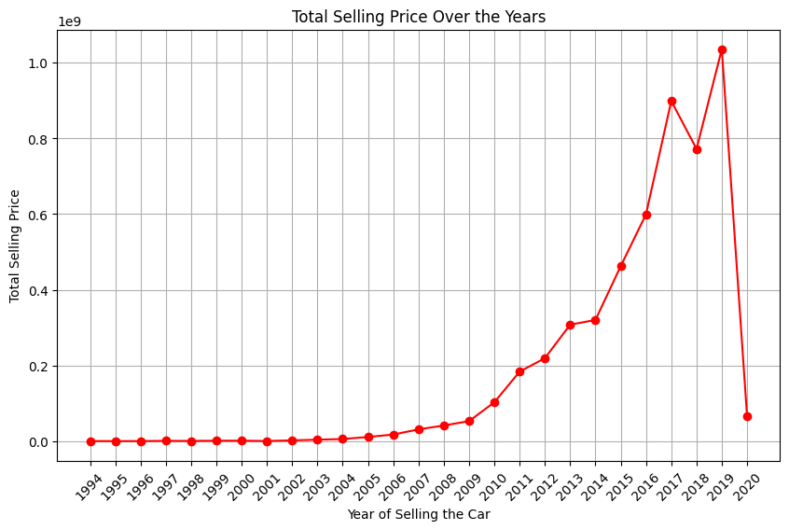
Total Selling Price Over the Years
A sharp rise in total selling price is observed from 2011 onward, indicating a surge in used car transactions
The peak occurs around 2019, suggesting maximum sales volume or higher-value cars in that year
The sudden drop in 2020 likely reflects market impact due to the COVID-19 pandemic
The steady growth before 2011 shows a gradual increase in demand and car resale activity
Insights can help understand market trends and seasonal shifts in car selling patterns

Slide 9
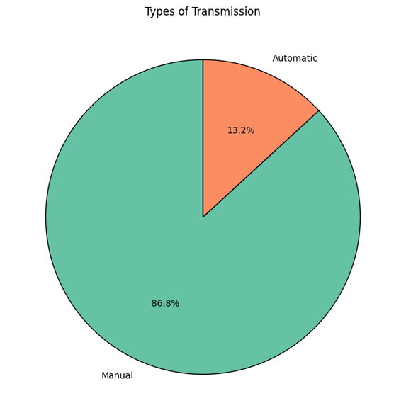
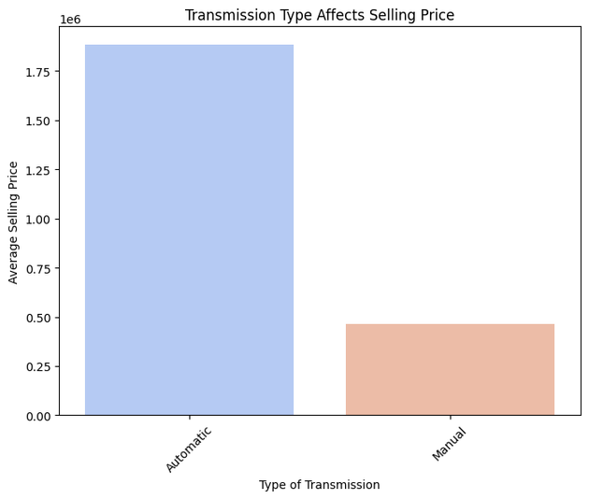
Types of Transmission
Majority of cars in the dataset have manual transmission (86.8%), showing a strong market preference
Automatic cars are less common (13.2%), which may influence model accuracy for this category
Transmission vs. Selling Price
Automatic cars have a much higher average selling price than manual cars
Despite lower frequency, automatic transmission adds significant value to a car’s price

Slide 10
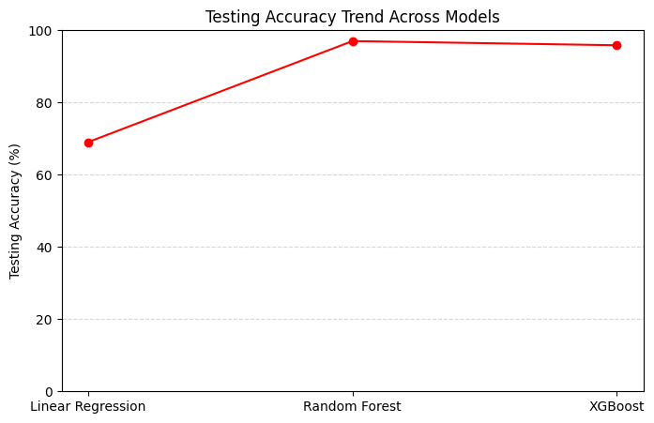
Model Accuracy Comparison
Random Forest achieved the highest accuracy (~97%), making it the best performer
XGBoost also performed well, slightly below Random Forest in accuracy
Linear Regression had the lowest accuracy, likely due to its inability to handle non-linear patterns
The gap between Linear Regression and ensemble models highlights the importance of complex models for this task
Choosing Random Forest or XGBoost can significantly improve prediction reliability in car price estimation

Slide 11
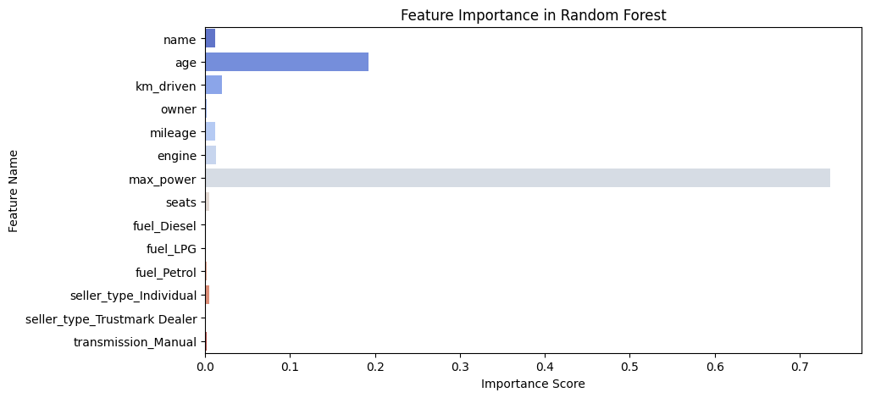
Feature Importance (Random Forest)
Max Power is the most influential feature in predicting car prices
Age of the car is the second most important factor, showing that newer cars hold more value
Features like engine size, mileage, and km driven have moderate impact
Variables such as fuel type, seller type, and transmission have relatively low importance
Understanding feature importance helps in refining models and focusing on impactful variables

Slide 12

Conclusion
Built a car price prediction model using Random Forest with 97% accuracy
Identified important features like max power, age, brand, and mileage
EDA revealed trends in car brands, years, and transmission types
Model helps make informed, fair pricing decisions in the used car market
Can be extended for use in real-time pricing tools or dealership platforms

Slide 13


